Slide 1
Medicinsamtaler for farmakonomer
Notes:
https://www.farmakonom.dk/kalender/arrangement/?id=21013
Medlemswebinar: Medicinsamtaler for farmakonomer
Farmakonomer har en vigtig rolle i at gennemføre medicinsamtaler på apotekerne. På dette webinar vil vi dele, hvordan du kan komme godt i gang med at lave medicinsamtaler, hvordan fanger du målgruppen til en medicinsamtale, i skranken.
Tidspunkt
10. juni 2026
Kl. 8.00 - 9.30
10. Septmeber 2026
Kl. 19.00-20.30
Du vil desuden høre, hvordan du sikrer dig, at I taler om det der er vigtigt for patienten – og hvordan du har en god samtale med patienter om deres compliance.
Det får du ud af at deltage:
· Indsigt i hvad en medicinsamtale er
· Blive klogere på compliance og hvad der kan være vigtigt for patienten
· Cases fra farmakonomer, der lykkes med medicinsamtaler
· Hvordan har farmakonomer det med at gennemføre medicinsamtaler – nyt fra forskning
Webinaret bliver afholdt af Lykke Fugl Nymark, som selv har erfaring i at gennemføre medicinsamtaler fra sin tid på apotek, og som har undervist og trænet mange i samtalerne.

Slide 2

Hvad skal vi tale om i dag:
Medicinsamtalen og compliance, hvad er vigtigt for patienten?
Case fra Kristine fra Rødding Apotek
Nyt fra forskningen
Notes:
1: Indsigt i hvad en medicinsamtale er
2: Blive klogere på compliance og hvad der kan være vigtigt for patienten
3: Vi skal undervejs høre en video hvor XX fra Rødding Apotek har delt sine erfaringer med at afholde medicinsamtaler
Også skal vi inden vi skal opsummere det hele også lige forbi vores forskningsafdeling her på Pharmakon og høre hvad resultaterne fra to projekter omkring medicinsamtaler har vist – særligt med fokus på den del der handler om hvad hvordan farmakonomers oplevelse er af at holde medicinsamtaler.
Jeg håber I finder det spændende og skal endelig bare stille spørgsmål undervejs.

Slide 3
Medicinsamtalen
Notes:
Kilder:
Manual, Medicinsamtale – Nydiagnosticeret kronisk sygdom, Medlemsnettet, 7. udgave, februar 2025
Bekendtgørelse om medicinsamtale på apotek, BEK nr 1563 af 09/12/2024, hentet 03-11-2025, https://www.retsinformation.dk/eli/lta/2024/1563
Kilde: Use of medicines by the elderly – the role of pharmacy in promoting adherence. The Netherlands. (2018)
4.4.4 Counselling and provision of cognitive pharmaceutical services
Pharmacist counselling services were the most frequently reported initiatives designed to promote adherence. Counselling took place both at the time of dispensing new and continuing medicines and subsequently for follow-up. Counselling by pharmacists should be considered at two levels: (i) the advice that pharmacists traditionally give when dispensing a medicine; and (ii) cognitive services above and beyond this advice. Specific programmes to enhance counselling refer to the latter.
While prescribers provided information about diagnoses and treatment plans, pharmacists usually took responsibility for counselling patients and carers regarding their medicines. Particular efforts were made when new medicines were introduced, and significant national programmes to support the introduction of new medicines were in operation in some jurisdictions (see sections 4.5, 4.8.3 and 4.8.4 below). These programmes had been subjected to evaluations, and evidence suggested that they resulted in significantly improved adherence.
Pharmacists also took responsibility for discussing changes in medication with patients and carers. These changes could involve adding or removing medicines from a regimen, changes in the dose or frequency prescribed, and changes in medicine brands or manufacturers, with the consequence that the dispensed tablets or capsules appeared unfamiliar to patients. In situations where the pharmacist was uncertain about a prescription or the patient or carer raised concerns with the pharmacist about a prescription, the programmes made provision for involvement of the prescriber in the discussion.
Motivational interviewing was an important element in the cognitive services. In general, the objectives of motivational interviewing were to discuss patients’ concerns about medicines, help them to manage any side effects, and explain the importance of adherence.
Several respondents reported on the conduct of home medicine reviews in their respective jurisdictions. Home medicine reviews provided an opportunity for pharmacists to investigate problems that patients encounter with their medicines, and to suggest ways of managing polypharmacy, drug interactions and related complications. Such reviews also provided an opportunity to assess the usage of over-the-counter (nonprescription) medicines and alternative medicines, and to consider whether or not these might interact with medicines. However, despite their potential benefits, some major barriers of time and logistics militated against their frequent use. Home medicine reviews were either initiated by the prescriber or required the involvement and endorsement of the prescriber.
4.5 Promoting adherence for specific conditions and medicines
While many of the pharmacy initiatives were designed to promote adherence across a wide range of conditions and for a wide range of types of medicines, others had been developed for the management of specific conditions or groups of conditions.
For example, pharmacists in Denmark conducted programmes to instruct patients in the correct use of inhalers to deliver medicines for asthma and COPD, and to monitor and promote their correct use on an ongoing basis. Community pharmacists in Belgium formed the nucleus of multidisciplinary groups of health professionals aiming to promote adherence to programmes and medication for osteoporosis. Swiss pharmacists participate in inter-professional programmes for chronic conditions, specifically HIV, multiple sclerosis, type 2 diabetes mellitus, metabolic syndrome, and for patients taking oral cancer drugs. The efforts of Spanish pharmacists were also directed at asthma and COPD, as well as hypertension.
The New Medicine Service (NMS), targeting patients of all ages who were taking newly prescribed medicines on a long-term basis, was introduced in England in 2011 and pilot-tested in Ireland in 2017. In the NMS, pharmacists conducted a structured education and adherence programme for patients with a newly diagnosed chronic disease. The conditions and medicines covered in the Irish NMS are listed in section 4.8.4.
The Danish Ministry of Health also mandates that pharmacies provide a New Medicine Service, introduced in 2016. The Danish NMS consists of two consultations with a pharmacist, each typically taking about 10 minutes. The first consultation, in the pharmacy, is usually held on the day when the new medicine is first dispensed, and the second is scheduled for three to four weeks later, and can be held at the pharmacy or over the telephone
4.8.3 Denmark
The Association of Danish Pharmacies has identified four initiatives relevant to adherence: New Medicine Service; Inhalation Technique Assessment Service; Multi-Dose Dispensed Medicines; and Medication Review.
New Medicine Service
Patients are recruited into the national New Medicine Service by the pharmacist or through referral by the general practitioner. The service, which was inaugurated in 2016, consists of two confidential consultations, the first at the time when the patient collects a new medicine for a newly diagnosed chronic disease. The second consultation is held three to four weeks later and may either be face-to-face or by telephone. In the course of the consultations, the pharmacist sorts out drug-related problems and concerns, discusses opportunities to improve the way the medicine is taken, and provides additional information about the condition and the medicine.
The New Medicine Service is specified under Danish pharmacy legislation and pharmacists are obliged to deliver it. It is funded through an agreement between the Association of Danish Pharmacies and the Ministry of Health, and is free of charge for the patient. No specific credentialing is required.
Inhalation Technique Assessment Service
The Inhalation Technique Assessment Service, which began in 2006, is designed for people with asthma and COPD, who are instructed in and have a demonstration of inhalation technique. While the service targets firsttime users, it is also available for multiple users. The patient receives advice on how to prepare the inhaler, how to hold it, how to inhale, how to close the inhaler and store it, the use of multiple doses, and mouth washing. Pharmacy staff document the advice given to each patient on a registration form. If necessary, the inhaler confidently and correctly. The patient is referred to a doctor if he or she has persisting problems in using an inhaler, or does not respond to the inhaled medication.
The service is conducted under an agreement between the Association of Danish Pharmacies and the Ministry of Health. It is funded by the Danish Government, and is free of charge to the patient. Pharmacists are paid on a fee-for-service basis.
There is no formal training for the s competencies. However, pharmacists providing the service must be credentialed. This is based on a multiplechoice examination and documentation of five instances of delivering the service.
The service has been evaluated and shown to be acceptable and effective.4
Multi-dose dispensed medicines
Under legislation passed in 2001, Danish pharmacists are required to supply drugs in automated dose packs. This has been identified as being of particular value for older patients. Dose-pack pharmacies are accredited by the Danish Medicines Agency, and this accreditation includes permission to install dispensing machinery that automatically makes up dose packs. A qualitative study conducted in 2008 concluded thus: The general impression from the analysis is that automated dose dispensing in . . . primary care . . . is a technology with good, potential opportunities to improve the medication of weak patients in particular, but that there are risks involved and many potential obstacles 5 Dose dispensing fees are paid by individual patients, but may be reimbursed if the medicines involved are eligible for reimbursement.
Medication review
Medication review was introduced in Denmark in 2010, and the Association of Danish Pharmacies has developed the programme including manuals, guidelines and credentialing of pharmacists to perform the reviews. Credentialing is based on written case reports and delivery of five services according to the guidelines. Medication reviews are conducted intermittently on a local basis, and patients or institutions pay for them. Further information is available from:

Slide 4

Medicinsamtale
1. januar 2025 har farmakonomer fået mulighed for at gennemføre medicinsamtaler jf. bekendtgørelsen om compliancesamtaler på apotek.
Medicinsamtale
Bekendtgørelsen træder i kraft den 1. januar 2016
Ny bekendtgørelse
1. januar 2025
Notes:
Begge samtaler er en del af apotekets sundhedsydelser, som har til formål at:
Øge borgerens forståelse for sin medicinske behandling.
Styrke medicinefterlevelse (compliance/adherence).
Forebygge medicinfejl og utilsigtede hændelser.
Skabe dialog mellem borger og apotek om medicinbrug, bivirkninger, tilskud og praktiske udfordringer.
Medicinsamtale:
Farmaceut
Farmakonom der har gennemgået uddannelsen ”Efteruddannelse til farmakonomer der skal afholde medicinsamtale”

Slide 5
Medicinsamtale
Målgrupper
  Patienter, der indenfor de seneste seks måneder har fået ordineret lægemiddelbehandling i forbindelse med diagnosticering af en kronisk sygdom
  Samtalen handler om compliance i forhold til den nye medicin
  Målgruppen gælder både børn og voksne
Pligt
  Apoteket har pligt til at tilbyde en samtale til patienter i målgruppen, når:
    der foreligger en henvisning fra en læge
    apoteket har vurderet, at der er behov for en
    medicinsamtale ud fra den konkrete ekspedition
Kilde: Medicinsamtale – Nydiagnosticeret kronisk sygdom, Manual, 2025
Notes:
Hvad er kronisk sygdom? I manualen: sygdom der har et langt forløb eller er tilbagevendende.
Begge samtaler omhandler compliance. Og er fordelt på to samtaler – HUSK at sige det – OPFØLGNING ER VIGTIG.
Medicinsamtalen er for at støtte borgeren i den nye medicin, så de ikke bliver non-compliante.
Compliancesamtalen er for at hjælpe borgeren med selv at finde løsninger så de bliver compliante igen.

Slide 6
Formålet med samtalen
”Formålet med denne samtale er at forebygge problemer med compliance ved, med udgangspunkt i patientens behov, at have en patientcentreret dialog, der baseres på det, der betyder noget for patienten. Det skal sikre, at patienten kommer godt i gang med behandlingen og på sigt opnår den ønskede effekt af behandlingen.”
Kilde: Medicinsamtale – Nydiagnosticeret kronisk sygdom, Manual, 2025
Notes:
Fra compliancehæftet:
Medicinsamtale: Nydiagnosticeret kronisk sygdom tilbydes borgere, som inden for de seneste seks
måneder har fået ordineret medicin i forbindelse med diagnosticeringen af en kronisk sygdom.
Compliance og medicinefterlevelse. Formålet med denne samtale er at forebygge problemer med compliance ved, med udgangspunkt i borgerens behov, at have en dialog om viden, vaner og vanskelige situationer og derved støtte
borgeren til god compliance. Det skal sikre, at borgeren kommer godt i gang med behandling med
medicinen og på sigt opnår effekt af behandlingen.

Slide 7
Materialer på Apoteksforum
Kundemødet → Sundhedsydelser
  Medicinsamtale
Rammerne for medicinsamtalen findes på medlemsnettet og i efteruddannelsen
Find desuden manualen og tilhørende materialer til ydelsen
Notes:
Rammerne omkring medicinsamtalen er
Samtykke fra kunden:
Vi skal have samtykke til opslag i FMK. Det skal gøres for at sikre at patienten er i målgruppen (kronisk diagnose indenfor 6 mdr.) Der er ikke krav om, at samtykket skal være skriftligt.
Kunden skal give samtykke til samtalen – det kan gives, mens farmakonomen/farmaceuten fortæller om samtalerne.
Der skal også gives samtykke til, hvis der opbevares oplysninger om kunden, til brug for den opfølgende samtale.

Slide 8
Hvad er compliance?
”En persons adfærd i forhold til at tage sin medicin, følge en diæt, og/eller at gennemføre livsstilsændringer, der er samstemmende med de aftalte anbefalinger indgået med en sundhedsprofessionel”
Compliance/adherence/medicinefterlevelse
Partnerskab og fælles beslutningstagning
Kilde: Compliance og medicinefterlevelse, Pharmakon, 2024
Notes:
Jeg har fortalt det her med at formålet er complaince – hvad er det nu compliance er – lad os kigge på definitionen.
Kilde: Pharmakon, Compliance og medicinefterlevelse, Evidens, teori og praksis på apotek, 2021
Compliance er et kendt begreb i Danmark. Begrebet er engelsk og er oprindeligt defineret som ”graden af overensstemmelse mellem borgerens faktiske medicinindtagelse og den ordinerede behandling” (3, 4). Forholdet mellem borgeren og den sundhedsprofessionelle har udviklet sig gennem årene, og det samme gør sig gældende for compliancebegrebet og hvad der ligger i det. I Danmark benyttes begrebet stadig, men forstås anderledes. I international litteratur benyttes begrebet ”adherence”.
Compliance: I international litteratur bruges begrebet “adherence”, som defineres af WHO som:
”En persons adfærd i forhold til at tage sin medicin, følge en diæt, og/eller at gennemføre livsstilsændringer, der er samstemmende med anbefalinger fra en sundhedsprofessionel” (1).
I dette hæfte bruger vi ordet ”compliance” og ikke ”adherence”, da compliance er det anerkendte ord at bruge i Danmark.
I vores arbejde med compliance arbejder vi ud fra, at alle aftaler indgås i samarbejde med borgerne, og derfor er tæt på nedenstående definition: ”En persons adfærd i forhold til at tage sin medicin, følge en diæt, og/eller at gennemføre livsstilsændringer, der er samstemmende med de aftalte anbefalinger indgået med en sundhedsprofessionel” (2).
I materiale fra Danmarks Apotekerforening bruges ”medicinefterlevelse”, hvilket er ensbetydende
med compliance, som det er beskrevet ovenfor.
Kilde: Use of medicines by the elderly – the role of pharmacy in promoting adherence. The Netherlands. (2018)
Adherence - defined in more detail below - refers to the correct use of a medicine. Adherence requires the engagement of patients and those who might benefit from taking medicines for preventive reasons. Engagement means trust and mutual respect between patient and health professional; an understanding by the health professional of the patient’s concerns, wishes, motivations and expectations, and a common setting of goals for prevention and/or therapy.
Health professionals must recognise that non-adherence may be unintentional (due, for example, to forgetfulness or difficulty with the management of medication regimens) or intentional (resulting from the patient’s unwillingness or incapacity to till a prescription, or unwillingness to start or continue taking a medicine as recommended by a health professional).
5.1 Implications of this review
Seven major implications emerge from this review.
First, non-adherence to medication is a persisting and widely recognised problem in the elderly, despite the introduction of many interventions to promote adherence. Non-adherence has a high cost in both human and economic terms.
Second, pharmacy has a prominent position in the sequence of events involved in the use of medicines, and has an essential role in promoting and monitoring adherence. Other than patients, none of the participants in this sequence of events contributes as much to them, or has such a comprehensive view. contributions encompass education and counselling of patients and their carers, providing and often assembling dose administration aids, dispensing medicines, generating reminders to take medicines and to refill prescriptions, and following patients to identify and resolve difficulties with their use.

Slide 9
Hvorfor er compliance vigtigt?
Kun den medicin, der indtages, virker
Konsekvenser:
  Forværring, indlæggelser
  Øgede sundhedsudgifter
Tiltagende pres på sundhedsvæsenet, multisyge og stigende antal ældre
Estimeret at omkring 50 % af patienter med kronisk sygdom har problemer med compliance
Kilde: Compliance og medicinefterlevelse, Pharmakon, 2024
Notes:
Kun den medicin, der indtages, virker
Noncompliance har store kliniske og økonomiske konsekvenser. De kliniske konsekvenser
afhænger af:
• Sygdommen, som patienten tager medicin for
• Effekten af medicinen
• Graden af noncompliance
• Medicinens farmakologiske egenskaber (48).
Noncompliance kan føre til forringet behandlingseffekt. Fx er compliancegraden hos patienter med type 2-diabetes 36-93 % (49, 50). Det er vist i flere studier, at noncompliance medfører, at flere patienter med type 2-diabetes ikke når behandlingsmålene og dermed får ringere helbred (51, 52).
Der er bred enighed om, at de økonomiske konsekvenser af noncompliance er væsentlige. De er dog svære at gøre op, og der er derfor vidt forskellige bud på det præcise omfang. De økonomiske omkostninger afspejler sig i de problemer, som kunne have været forebygget med korrekt medicinbrug, fx kan noncompliance medføre ekstra henvendelser til sundhedsvæsenet og unødvendige indlæggelser. Hertil kommer medicinspild, hvor medicin, som er købt og dispenseret, ikke tages af patienten (48).
Også er der et tiltagende pres på sundhedsvæsnet – vi ser flere multisyge – og et stigende antal ældre.
Lig mærke det der som står herovre på slide – at det er estimeret XXX. Det svarer altså til hver anden af de kunder i ekspederer hver dag som har en kronisk sygdom (hvilket udgør en kæmpe andel). Det er nogen af de her complianceudfordringer vi skal være med til at forebygge ved at afholde medicinsamtaler.
Lad os se på sammenhængen mellem compliance i medicineringsprocessen og medicinsamtalen.

Slide 10
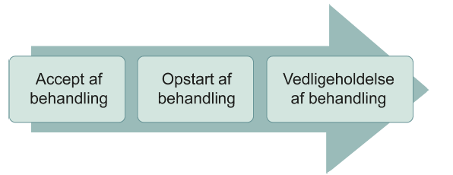
Medicineringsprocessen
Diagnose
Afhentning af medicin på apotek
Figur: De tre faser i forbindelse med compliance. Kilde: Compliance og medicinefterlevelse, Pharmakon, 2024
Notes:
Kilde: Pharmakon, Compliance og medicinefterlevelse, Evidens, teori og praksis på apotek, 2024
Der er flere beslutninger, patienten skal tage, flere handlinger, der skal igangsættes, og flere
interaktioner mellem flere aktører i løbet af medicineringsprocessen. Det gør
medicineringsprocessen til en kompleks proces, hvor apoteket har en vigtig rolle.
Medicineringsprocessen omfatter følgende (48):
• Diagnose. Patienten får en diagnose, som kræver behandling. På basis af diagnosen og
patientens ønsker formuleres en behandlingsplan. Her er det den ordinerende læges
opgave at diagnosticere og fastlægge en plan sammen med patienten. Patienten involveres
i beslutninger om sin behandling.
• Accept af behandling eller beslutning om at handle på baggrund af diagnosen. Her er det
patientens beslutning, om de vil acceptere behandlingen. I nogle tilfælde spiller de
pårørende og/eller plejepersonalet ind, fordi de har overtaget ansvaret for
medicingivningen. Her er der flere faktorer, der kan spille ind, herunder patientens egne
og/eller den pårørendes ønsker og overbevisninger/holdninger, deres intellektuelle eller
emotionelle engagement i sygdommen og deres motivation for at gøre noget ved den. En
anden faktor er at huske at indløse recepter, samt patientens økonomi og om patienten har
råd til at følge behandlingen.
• Forsyning og distribution af medicinen. Medicinforsyningen afhænger af
medicinproducenterne og importørerne/distributørerne af medicinen. Distributørerne
opbevarer medicinen og afleverer den hos apotekerne eller andre
medicinafhentningssteder, hvor der typisk er apotekspersonale.
• Afhentning af medicinen på apotek. Her kommer patienten i kontakt med
apotekspersonalet. Apoteket laver en farmakologisk kontrol af recepten, tjekker, om
medicinen er hjemme, henter medicinen og giver den til patienten. Apotekets opgave i den
forbindelse er også at behovsafdække og rådgive patienten om fx korrekt brug af
medicinen og compliance. Apotekspersonalet kan også anbefale ikke-receptpligtig medicin
ved behov.
• Opstart af behandling. Patienten, evt. med hjælp fra pårørende og/eller plejepersonale,
påbegynder behandlingen. Påbegyndelsesfasen har en afgørende betydning for patientens
compliance. Hvis patienten får en negativ oplevelse eller opfattelse af medicinen (fx på
grund af, at det er svært eller ubehageligt at følge den, eller fordi det medfører bivirkninger
at følge den), kan det betyde, at patienten stopper behandlingen. Patienterne kan tage en
mindre dosis end anbefalet for at vurdere medicinens effekt og bivirkninger, eller de kan
tage en højere dosis end anbefalet for at opnå en hurtigere eller større effekt. Begge dele
er udtryk for problemer med compliance.
Kilde: Manual, Medicinsamtale – Nydiagnosticeret kronisk sygdom
Dialog med patienten
Det er farmaceutens/farmakonomens ansvar at afdække patientens oplevelse af sit eget liv med sygdom og medicin. Det er samtidig væsentligt, at farmaceutens/farmakonomens sundhedsfaglige viden deles med patienten, når det er relevant.
Medicinsamtalen skal tage udgangspunkt i patientens perspektiv på egen hverdag med medicin. Farmaceuten/farmakonomen kan være nysgerrig på patientens erfaringer, værdier og præferencer i forhold til patienternes behandling. Derved får patienten mulighed for at reflektere over, hvad der er vigtigt, og finde frem til de muligheder, som passer patienten bedst. Farmaceuten/farmakonomen kan sammen med patienten finde frem til en praksis, som er holdbar i hverdagen, motiverer og gør det lettere for patienten at gennemføre sin behandling.
Farmaceuten/farmakonomen opsummerer sammen med patienten, hvad de har talt om, fx viden, refleksioner og løsninger. Dette følges der op på til en opfølgende samtale. Det vil være individuelt, om og hvad patienten har brug for at få med hjem på skrift for at tage sin medicin korrekt, men da patienten skal informeres om samtalen gennem udlevering af medicinsamtalekortet, så kan relevant information noteres her.
Kilde: Bekendtgørelse om medicinsamtale på apotek, BEK nr 1563 af 09/12/2024
§ 5. En medicinsamtale skal øge borgerens kendskab til den ordinerede medicinske behandling for den eller de kroniske sygdomme, som borgeren lider af, og informere og yde råd og vejledning om bedre me-dicinefterlevelse. Herudover har borgeren såvel som apotekeren eller den af apotekeren ansatte farmaceut eller farmakonom mulighed for at bringe forhold af betydning for medicineringen og efterlevelsen, f.eks. om medicintilskud, op ved medicinsamtalen.
Stk. 2. Apotekeren kan i forbindelse med medicinsamtalen udlevere skriftligt materiale.

Slide 11
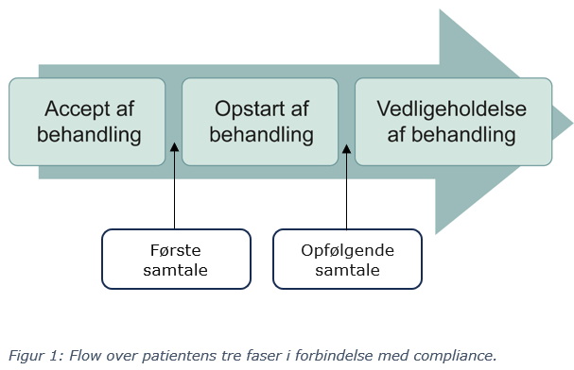
Medicinsamtalen
Kilde: Medicinsamtale – Nydiagnosticeret kronisk sygdom, Manual, 2025
Notes:
Omdrejningspunktet for begge samtaler
Kilde: Manual, Medicinsamtale – Nydiagnosticeret kronisk sygdom
Dialog med patienten
Det er farmaceutens/farmakonomens ansvar at afdække patientens oplevelse af sit eget liv med sygdom og medicin. Det er samtidig væsentligt, at farmaceutens/farmakonomens sundhedsfaglige viden deles med patienten, når det er relevant.
Medicinsamtalen skal tage udgangspunkt i patientens perspektiv på egen hverdag med medicin. Farmaceuten/farmakonomen kan være nysgerrig på patientens erfaringer, værdier og præferencer i forhold til patienternes behandling. Derved får patienten mulighed for at reflektere over, hvad der er vigtigt, og finde frem til de muligheder, som passer patienten bedst. Farmaceuten/farmakonomen kan sammen med patienten finde frem til en praksis, som er holdbar i hverdagen, motiverer og gør det lettere for patienten at gennemføre sin behandling.
Farmaceuten/farmakonomen opsummerer sammen med patienten, hvad de har talt om, fx viden, refleksioner og løsninger. Dette følges der op på til en opfølgende samtale. Det vil være individuelt, om og hvad patienten har brug for at få med hjem på skrift for at tage sin medicin korrekt, men da patienten skal informeres om samtalen gennem udlevering af medicinsamtalekortet, så kan relevant information noteres her.
Kilde: Bekendtgørelse om medicinsamtale på apotek, BEK nr 1563 af 09/12/2024
§ 5. En medicinsamtale skal øge borgerens kendskab til den ordinerede medicinske behandling for den eller de kroniske sygdomme, som borgeren lider af, og informere og yde råd og vejledning om bedre me-dicinefterlevelse. Herudover har borgeren såvel som apotekeren eller den af apotekeren ansatte farmaceut eller farmakonom mulighed for at bringe forhold af betydning for medicineringen og efterlevelsen, f.eks. om medicintilskud, op ved medicinsamtalen.
Stk. 2. Apotekeren kan i forbindelse med medicinsamtalen udlevere skriftligt materiale.

Slide 12

Årsager til noncompliance
Årsagerne til, at patienter ikke altid tager deres medicin, er individuelle. Derfor findes der ikke én løsning til at afhjælpe manglende compliance for alle.
Med udgangspunkt i de fire emner; vaner og vanskelige situationer, medicin, motivation og viden, kan man finde inspiration til, sammen med patienten, at finde årsager til dennes manglende compliance.
Notes:
LIN
Forberedelse
Print figuren med Vaner og vanskelige situationer, Medicin, Motivation og Viden samt udsagns-brikkerne fra dokumentet ”Årsager til noncompliance”
Farmonomen/farmakonomerne skal nu placere udsagnene ved den rigtige del af figuren; Vaner og vanskelige situationer, Medicin, Motivation og Viden.
Løsningen findes på næste dias.

Slide 13
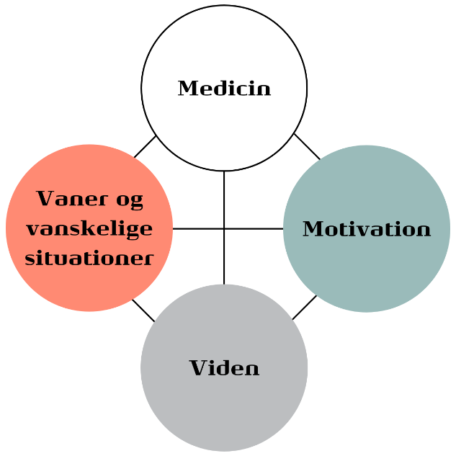
Hvilke emner fylder?
Kilde: Medicinsamtale – Nydiagnosticeret kronisk sygdom, Manual, 2025
Notes:
Til underviser: Præsenter – forklar evidensen bag, hvad emnerne dækker over og at der er en helhed – de enkelte ”bobler” vender vi tilbage til når vi skal snakke medicinsamtalen om lidt.
Kilde: Pharmakon, Compliance og medicinefterlevelse, Evidens, teori og praksis på apotek, 2024
Årsagerne til, at patienter ikke altid tager deres medicin, er individuelle. Derfor findes der ikke én løsning til at afhjælpe manglende medicinefterlevelse for alle. Indholdet kan derfor ikke fastsættes på forhånd, men skal i dialog med patienten tilpasses patientens behov og ressourcer.
Da samtalen med patienten skal forebygge, identificere og løse udfordringer med medicinefterlevelse, er det vigtigt, at dialogen med patienten tager udgangspunkt i det, der betyder noget for netop denne patient.
Det er ikke nødvendigt at gennemgå alle modellens elementer for hver eneste patient. Ved hjælp af spørgsmål og dialog med den enkelte patient afdækkes årsager og mulige løsninger, som kan fungere i patientens hverdag.
Elementerne i indercirklen er forbundet med hinanden. Det illustrerer, at elementerne skal
ses som en helhed. Fx kan mere viden om fordelene ved behandlingen hos nogle patienter
motivere til at tage medicinen, og det kan give anledning til, at patienten finder nogle gode vaner,
så det bliver gjort. Start gerne samtalen med at spørge patienten, hvad der er vigtigt for dem i forhold til deres
sygdom og behandling.
Kilde: Manual, Medicinsamtale – Nydiagnosticeret kronisk sygdom
Dialog om compliance med patienten
Fra forskning ved vi, at forskellige emner kan have indflydelse på, om patienten tager sin medicin, nemlig vaner og vanskelige situationer, medicin, motivation og viden. Det er forskelligt, hvad der betyder noget for den enkelte patient. Der er ikke nogen bestemt rækkefølge i emnerne. Undersøg, hvad der er vigtigt for netop den patient, du taler med.
Nedenstående er en beskrivelse af, hvad emnerne dækker over, og hvad der kan give udfordringer med compliance hos patienterne (figur 2).

Slide 14
Compliance
Figur 2: Dialog om medicin. I dialogen med patienten kan du anvende figuren som hjælp til at identificere, hvilke emner, der fylder hos patienten i forhold til at skulle starte ny medicin.
Kilde: Medicinsamtale – Nydiagnosticeret kronisk sygdom, Manual, 2025
Notes:
Evidensbaseret.
Under hver del af modellen er det beskrevet hvad et kæmpe sammenkog af forskning viser ved hjælp af forskningsartikler fra forskellige nordiske lande – det har Pharmakon samlet i litteraturstudier.
Modellen hjælper med hvad der kan være en udfordring for patienten – det som fylder for kunden, det er relevant for samtalen.
Kilde: Manual, Medicinsamtale – Nydiagnosticeret kronisk sygdom
Dialog om compliance med patienten
Fra forskning ved vi, at forskellige emner kan have indflydelse på, om patienten tager sin medicin, nemlig vaner og vanskelige situationer, medicin, motivation og viden. Det er forskelligt, hvad der betyder noget for den enkelte patient. Der er ikke nogen bestemt rækkefølge i emnerne. Undersøg, hvad der er vigtigt for netop den patient, du taler med.
Nedenstående er en beskrivelse af, hvad emnerne dækker over, og hvad der kan give udfordringer med compliance hos patienterne (figur 2).

Slide 15
Notes:
Kilde: Manual, Medicinsamtale – Nydiagnosticeret kronisk sygdom
Vaner og vanskelige situationer
Gode vaner sikrer, at medicinen bliver taget i hverdagen. Det er forskelligt, hvilke vaner og rutiner, der fungerer for den enkelte patient.
Der kan opstå vanskelige situationer, hvor vanerne i hverdagslivet bliver brudt, hvilket kan gøre, at patienten ikke tager sin medicin som aftalt.
Forskning viser, at patienter oplever, at det at tage medicin kan være forstyrrende for det personlige og sociale liv, fx hvis patienten skal til at tage nye lægemidler eller flere end vanligt, eller at de oplever social stigmatisering, hvis de tager medicin foran andre. Forskning viser også, at når patienter oplever vanskelige situationer, hvor hverdagens vaner/rutiner bliver brudt, af fx ferie, sygdom eller andre ændringer i hverdagslivet, kan det påvirke patientens compliance.

Slide 16
Vaner og vanskelige situationer
Hvordan har du aftalt med lægen, at du skal tage din medicin?
Hvordan ser din daglige rutine ud, og hvordan ser du din nye medicin passe ind?
I hvilke situationer kan det være svært for dig at få taget medicinen?
Hvordan kan du gøre det lettere at huske at tage din medicin i forbindelse med dine daglige aktiviteter?
Kilde: Apoteksforum, Medicinsamtaler, Tilhørende materialer, Dialogkort

Slide 17
Vaner og vanskelige situationer
Vaner og rutiner i hverdagen
Særlige forhold ved faste og rutineændringer
Pillepas og rejseforhold
Brug af doseringsæske og huskeregler.
Notes:
På det her slide har jeg medtaget nogle resultater fra et af de projekter vi skal tale om senere, ” Dokumentation af Medicin- og Compliancesamtaler”, i det projekt bad man apoteksmedarbejderne, via en registrering efter hver samtale der blev afholdt i en periode, at uddybe, hvad der bliver talt om. Det er så blevet kategoriseret hvad de skrev, og her er et overblikket under temaet Vaner og vanskelige situationer. Vi kommer gennem dem alle fire.
Vaner og rutiner i hverdagen
Særlige forhold ved faste og rutineændringer
Pillepas og rejseforhold
Brug af doseringsæske og huskeregler

Slide 18
Notes:
Den næste del af figuren er medicin:
Kilde: Manual, Medicinsamtale – Nydiagnosticeret kronisk sygdom
Medicin
Dette emne handler om brugen af medicinen, fx i forhold til dosering, virkning, bivirkning, praktisk anvendelse og substitution. Det kan være med udgangspunkt i det enkelte lægemiddel og/eller den samlede medicinering. En dialog om, hvordan medicinen tages mest hensigtsmæssigt for at passe til patientens hverdag, kan hjælpe patienten til at få taget sin medicin.
Forskning viser, at hvis behandlingsplanen eller de fysiske egenskaber af medicinen ændres, som fx medicinens udseende, navn, farve, form m.m., kan det medføre potentielle udfordringer, hvor patienten oplever det vanskeligt at håndtere kompleksiteten af medicinen, og derfor ikke får taget medicinen.

Slide 19
Medicin
Hvad er dine tidligere erfaringer med at tage medicin?
Hvilke spørgsmål har du om, hvordan du skal tage din medicin?
Hvordan har du det med at skulle starte ny behandling?
Kilde: Apoteksforum, Medicinsamtaler, Tilhørende materialer, Dialogkort

Slide 20
Medicin
Tidspunkt for indtagelse
Med eller uden mad
Samtidig brug af flere præparater
Dosering og optrapning/udtrapning
Glemt dosis og håndtering heraf
Opbevaring
Bivirkninger, der kan opstå/er opstået
Forventet virkning og virkningsmekanisme
Hvornår effekten kan forventes
Tilskud og enkelttilskud
Restordre.
Notes:
Og fra projektet har man fundet følgende emner under overskriften medicin:
Tidspunkt for indtagelse (morgen/aften, ift. døgnrytme)
Med eller uden mad
Samtidig brug af flere præparater
Dosering og optrapning/udtrapning
Glemt dosis og håndtering heraf
Opbevaring (fx ved rejser og varme omgivelser)
Bivirkninger der kan opstår/ er opstået (mave-tarm, muskelsmerter, svimmelhed, hallucinationer, bradykardi m.fl.)
Forventet virkning og virkningsmekanisme
Hvornår effekten kan forventes
Tilskud og enkelttilskud
Restordre

Slide 21
Notes:
Kilde: Manual, Medicinsamtale – Nydiagnosticeret kronisk sygdom
Motivation
Der kan være forskellige faktorer, der motiverer patienten til at tage sin medicin, fx at få det bedre, at kunne mere i hverdagen m.v. Hvis motivation er en udfordring, er det væsentligt at finde ud af, hvad der er årsagen, og hvad der skal til, for at patienten vil tage sin medicin.
Vær opmærksom på, at det kan være et bevidst valg, at patienten ikke tager sin medicin.
Forskning viser, at motivation og tillid til den behandlingsansvarlige læge kan falde, hvis patienten ikke føler, at lægen tager hensyn til deres aktuelle situation og udfordringer. Manglende motivation kan dreje sig om manglende accept hos patienten af sygdom og diagnose, og de kan opleve, at de sygeliggøres ved at skulle tage medicin.

Slide 22
Motivation
Hvordan har du det med at skulle tage din nye medicin?
Hvad er vigtigt for dig at kunne gøre i fremtiden – har din medicin indflydelse på om du kan opnå det?
Hvordan kan vi sammen sikre, at du får mest muligt ud af din nye medicin?
Kilde: Apoteksforum, Medicinsamtaler, Tilhørende materialer, Dialogkort

Slide 23
Motivation
Samtaler om motivation og accept af behandling
Smertehåndtering ved stik
Sjældne bivirkninger og patientens bekymringer
Håndtering og forventning til bivirkninger
Manglende information fra læge
→ behov for viden og tryghed
Bekymringer ved opstart og afklaring af spørgsmål
Opfølgning og kontrol hos læge
Kost og motion
Mental sundhed og motivation.
Notes:
Under temaet motivation er der de her forskellige emner
Samtaler om motivation og accept af behandling
Samtaler om hvordan man kan håndtere smerter ved stik
Sjældne bivirkninger og patientens bekymringer
Håndtering og forventning til bivirkninger (fx at de kan aftage efter 14 dage)
Manglende information fra læge → behov for viden og tryghed
Bekymringer ved opstart og afklaring af spørgsmål
Opfølgning og kontrol hos læge
Kost og motion
Mental sundhed og motivation

Slide 24
Notes:
Kilde: Manual, Medicinsamtale – Nydiagnosticeret kronisk sygdom
Viden
Viden om sygdom og behandling kan have indflydelse på, hvordan patienten vælger at bruge sin medicin og tage hånd om sin sygdom. Det er individuelt, hvad patienten har brug for at vide, og det kan fx være viden om dosering, praktisk anvendelse, egenomsorg og særlige forhold ved medicinen eller sygdommen.
Forskning viser, at hvis patienten oplever at få utilstrækkelig eller modstridende information, kan det udfordre forståelsen for sygdommen og medicinen og have indflydelse på, hvordan patienten tager sin medicin. det betyder, at manglende viden kan føre til non-compliance hos patienterne.

Slide 25
Viden
Hvad har du brug for at vide om din sygdom og behandling?
Hvilke bekymringer har du omkring din sygdom og behandling?
Er der noget, du har brug for at vide mere om, for at være motiveret for at tage medicinen? Hvis ja, så hvad?
Kilde: Apoteksforum, Medicinsamtaler, Tilhørende materialer, Dialogkort

Slide 26
Viden
Compliance og vigtigheden af
at følge behandlingen
Sammenhæng mellem sygdom,
symptomer og medicinens formål
Injektionsteknik og brug af pen
Klargøring og påsætning af nål
Valg af stikkested
Brug af depotplastre
Inhalationsteknik.
Notes:
Under temaet viden er der de her forskellige emner
Compliance og vigtigheden af at følge behandlingen
Sammenhæng mellem sygdom, symptomer og medicinens formål
Injektionsteknik og brug af pen (inkl. demopen)
Klargøring og påsætning af nål
Valg af stikkested
Brug af depotplastre (hvordan og hvor de sættes på, skiftetidspunkt)
Inhalationsteknik

Slide 27
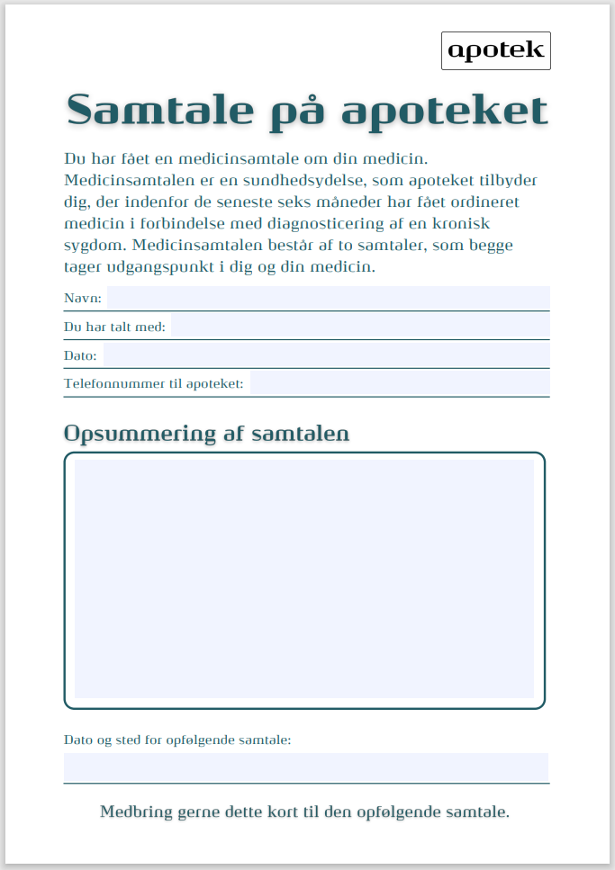
Medicinsamtalekort til udlevering
Krav om udlevering af medicinsamtalekort: Medicinsamtalekortet indeholder information om, hvad medicinsamtalen er, og hvad samtalen har handlet om. Kortet skal udleveres til patienten efter første del af medicinsamtalen
Kilde: Danmarks Apotekerforening 2025
Notes:
Den figur vi lige har snakket om, den fremgår også af medicinsamtalekortet – som er det i ser her til venstre.
Dette er tilføjet i forbindelse med den nye bekendtgørelse og revideringen af materialet, hvor farmakonomer må lave medicinsamtaler på apoteket.
Samtalekort er ikke en skal i bekendtgørelsen, men det er et krav at det skal dokumenteres, derfor har DA og STPS udarbejdet samtalekort, som kan bruges til dokumentation
Der står følgende i manualen:

Slide 28
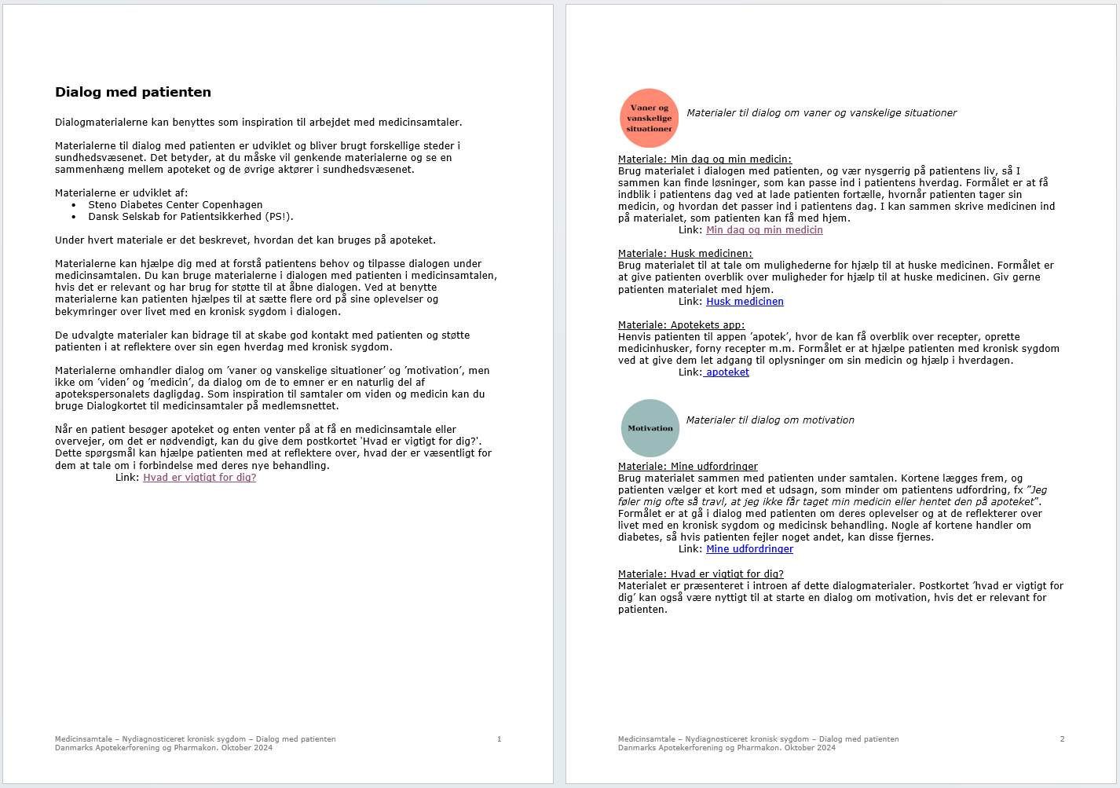
Brug tilhørende materialer
Kilde: Apoteksforum, Medicinsamtaler, Tilhørende materialer, Dialog med patienten
Notes:
Det her er også redskaber som kan hjælpe jer med at komme fra nybegynder i at afholde denne slags samtaler
Læringsteori viser at når man starter med nogle nye faglige områder, så vil man i starten være nybegynder før man kan bevæge sig videre til forskellige stadier før man bliver ekspert. Man har brug for at være i nybegynder rollen og acceptere at det faktisk er okay, så kan man bedre tage det ind og gå videre i læringstrin.
Metafor til at lære og cykle.
I dette materiale er der henvisning til ”Hvad er vigtigt for dig” fra Dansk Selskab for Patientsikkerhed.
Inde på deres side skriver de:
Er der noget, der fylder ekstra meget lige nu?
Hvad vil du gerne have ud af besøget her i dag?
Kan jeg gøre noget særligt for dig i dag?
Hvad er det, der gør en dag god for dig?
Er der noget vigtigt, jeg ikke har spurgt dig om?

Slide 29
Apotekets rådgivning og sundhedsydelser, der støtter compliance
Medicinsamtale
Compliancesamtale
TPI
Apotekets medicingennemgang
Genordination ved behandlerfarmaceut
Dosispakket medicin
Notes:
Og det her med compliance – det snakker I jo ofte om på apoteket – det er også det som andre sundhedsydelser – og rådgivning i skranken – handler om at sikre.
Nu har vi snakket lidt om hvad medicinsamtalen er, vi har snakket om compliance og sporet os ind på det er vigtigt at få gang i den personcentrerede dialog der tager udgangspunkt i kunden behov – som det også er skrevet i medicinsamtalens formål. Hvordan sikrer vi os at vi taler om det der er vigtigt for kunden? Til at snakke om det vil jeg gerne vise jer og snakke om Liv-Liv modellen.
Kilde: Pharmakon, Compliance og medicinefterlevelse, Evidens, teori og praksis på apotek, 2021
Sektorkrav for rådgivning er apotekssektorens overordnede ramme for apotekets rådgivning af
patienten. Ifølge sektorkravene skal patienten tilbydes rådgivning af høj faglig kvalitet, som tager
udgangspunkt i patientens aktuelle behov. Hvis det fx viser sig, at patienten har problemer med
compliance, støtter apoteket patienten i selv at finde løsninger med udgangspunkt i patientens
behov og ressourcer.
Apoteket kan tilbyde flere ydelser, som har til formål at sikre implementering af behandling hos
patienterne.
Medicinsamtale: Nydiagnosticeret kronisk sygdom tilbydes patienten, som inden for de seneste
seks måneder har fået ordineret medicin i forbindelse med diagnosticeringen af en kronisk
sygdom, da man ved, at specielt opstart af en ny behandling kan være en sårbar situation.
Formålet med denne samtale er at forebygge problemer med compliance ved, med udgangspunkt i
patientens behov, at have en patientcentreret dialog, der baseres på det, der betyder noget for
patienten. Det skal sikre, at patienten kommer godt i gang med behandlingen og på sigt opnår den
ønskede effekt af behandlingen.
Medicinsamtale: Manglende medicinefterlevelse ved kronisk sygdom tilbydes patienter, som har
fået ordineret medicin i mindst 12 måneder for en kronisk sygdom og har udfordringer med
compliance.
Formålet med denne samtale er, gennem en patientcentreret dialog, at identificere årsager til og
løse problemer med compliance ved fx at have en dialog om vaner og vanskelige situationer,
medicin, motivation og viden, alt med udgangspunkt i patientens behov og ressourcer. Samtalen
skal sikre, at patienten får en bedre compliance og på sigt en øget implementering af den aftalte
behandling.
Begge sundhedsydelser bygger på erfaring fra danske forskningsprojekter; Sikker og effektiv
medicinbrug samt Opstart af ny lægemiddelbehandling – hvordan sikres det, at medicinbrugeren
kommer godt i gang? (7, 8). Læs mere om evidensen bag apotekets sundhedsydelser i afsnittet
Danske forskningserfaringer om apotekets sundhedsydelser.
Patienter, der er i behandling med inhalationsmedicin, kan tilbydes sundhedsydelsen Tjek på
inhalation. Det gælder både nye og erfarne brugere, der har problemer med deres
inhalationsteknik. Formålet med ydelsen er at bidrage til at sikre, at brugere af inhalationsmedicin
anvender deres inhalationsmedicin korrekt, så de får så effektiv en behandling som muligt, samt at
forebygge og løse problemer med inhalationsmedicin, som skyldes forkert inhalationsteknik.
Ydelsen omfatter, at apotekspersonalet vurderer patientens inhalationsteknik ved demonstration
og feedback. Dermed støtter denne ydelse også op om implementering af behandling ved at
understøtte korrekt praktisk brug af medicinen. Ydelsen er udviklet på baggrund af resultater fra
flere danske forskningsprojekter (9-12).
Apotekets medicingennemgang til patienten er også en sundhedsydelse, som apoteket kan tilbyde.
Den har til formål at afklare og løse patientens lægemiddelrelaterede problemer og at styrke
implementering af den relevante behandling. Apotekets medicingennemgang bygger på erfaringer
fra tidligere forskningsprojekter (13-16).
Det er også muligt for en autoriseret behandlerfarmaceut på apoteket at genordinere medicin i den
mindst mulige pakning inden for bestemte lægemiddelgrupper. Det sikrer kontinuitet i
behandlingen og forebygger uønskede pauser med medicinen, som skyldes, at patienten har glemt
at forny recepten hos den ordinerende læge, eller at recepten ikke blev godkendt og sendt efter
bestilling. Dette tiltag støtter patientens compliance, så de kan fortsætte deres behandling uden
afbrydelser. Det er også muligt for behandlerfarmaceuten at tilbyde ordination af dosispakket
medicin med tilskud.
Apoteket kan tilbyde dosispakket medicin, ordineret af patientens læge eller af en
behandlerfarmaceut. Dosispakket medicin kan støtte patienten selv eller en pårørende i at sikre, at
den rette medicin tages på det rette tidspunkt. Dosispakket medicin kan være en hjælp for de
patienter, der har svært ved at have overblik over medicinen, eller har svært ved at huske at tage
deres medicin. Dette er med til at forebygge fejlmedicinering, og samtidig oplever patienten fortsat
at være selvhjulpen og involveret i behandlingen. Ordningen er evalueret i et tidligere dansk studie
(17).

Slide 30
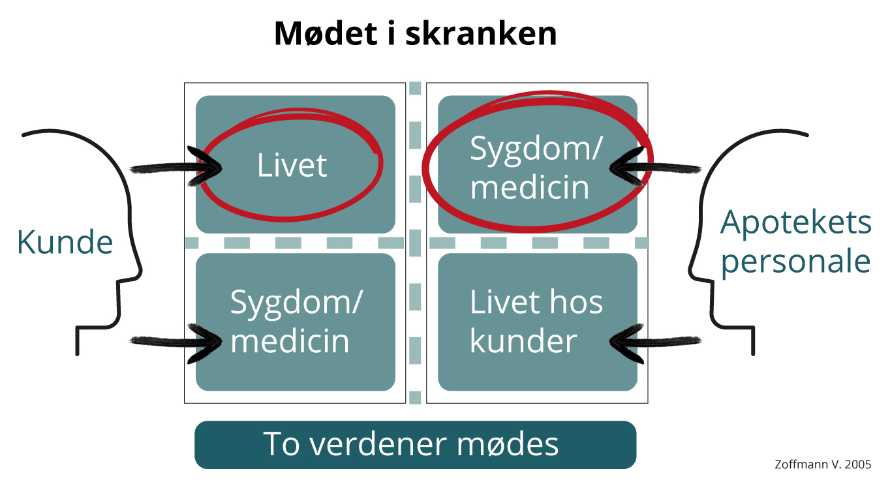
Notes:
Nogen af jer kender den måske fra et kursus eller gennem mentalisering. Liv/sygdom modellen.
På billedet ser I en model der illustrerer de forskellige perspektiver der mødes, når kunden kommer ind på apoteket.
Kunden har fokus på livet, som er det vigtigste for dem, samtidig har de en sygdom, som de skal tage medicin for. Kunden er ekspert i sit eget liv og sit eget liv med sygdom og medicin. De ved hvad der fungerer eller ikke fungerer for dem.
Linjen mellem livet og sygdom skal illustrere den konflikt som de kan være i, når de skal have liv og sygdom til at hænge sammen i deres hverdag. Fx at acceptere at have en sygdom, acceptere at skulle tage medicin, acceptere at skulle tage deres medicin fx på et bestemt tidspunkt. Så derfor kan de være i konflikt med sig selv. Den stiplede linje illustrerer denne konfliktzone.
Et eksempel:
Lars har fået konstateret type 2-diabetes og vil faktisk ikke ”have den her lortesygdom” og gør alt for at skjule det for andre. Han er hele tiden i en konflikt med sig selv, han ved godt han bør tage sig af sin sygdom for at forebygge følgesygdomme – men han har ikke accepteret diagnosen. Han vil gerne leve livet som alle andre, uden at blive set på som en der er syg.
Hvis vi ser på den anden side som skal illustrere, hvad der er vigtigst for apotekspersonalet, har de fokus på deres kerneopgave, som er at have fokus på sygdom og medicin. Apotekspersonalet er eksperter på behandlingen. Samtidig ved apotekspersonalet en masse om livet hos kunder på et generelt niveau. Fx kunder der får vanddrivende medicin eller kunder der er i behandling for BT. Apotekspersonalet har også en konfliktzone mellem sygdom/medicin og livet hos kunder, fordi sygdom/medicin er det primære fokus og fordi når vi tager afsæt i livet hos kunder så er det generel viden om hvordan kunder med netop denne sygdom har det i hverdagen med deres sygdom og medicin fremfor den konkrete kundes erfaringer og viden. Lad os fortsætte med Lars, allerede når man på skærmen har set han skal hente metformin, så kan forskellige vigtigt info – fx at tage metformin til et måltid for at undgå bivirkninger, være noget som kommer i tankerne. Men det baserer sig på generel viden om det at have diabetes og er ikke baseret på hvad vi ved Lars har brug for.
Når kunden og apotekspersonalet så møder hinanden med to forskellige perspektiver opstår der en konfliktzone mellem kunde og apotek, fordi kunden føler sig ikke hørt eller set – også selvom kunden faktisk inviterer til at tale om det som er vigtigt for ham/hende – og på den anden side oplever apotekspersonalet at kunden måske ikke hører efter, hvilket skyldes at personalet har fokus på sygdom og medicin og taler ud fra deres model af verdenen. Så vi mødes med et forskelligt udgangspunkt og taler ikke om det samme og har ikke nødvendigvis fokus på det samme.
Så man kan sige at hos kunden er der fokus på livet, og at hos apotekspersonalet er der fokus på det naturvidenskabelige ben. Fokus er først på medicinen og sygdom og generelt livet hos kundegruppen. Det giver os et ekspertfokus fremfor fokus på det enkelte menneske med det liv, han/hun lever og de udfordringer, der kan være med at få medicinen til at passe ind i livet.
Så to verdener mødes.
Så det er her, vi i stedet skal være nysgerrige og forsøge at møde kunden i livet med brug af interesse følelsen som det første og forstå den enkelte kundes hverdag. Der skal være fokus på personen først. Det handler ikke om kunder generelt, det handler om netop kunden der har fået en nydiagnosticeret kronisk sygdom, eller lige netop den kunde der står foran dig.
Så vi skal bytte rundt – så vi tager udgangspunkt i det samme perspektiv og møder kunden i livet som det første. Det illustrerer vi sådan her:

Slide 31

Notes:
Så når i ser modellen her står liv over for liv og sygdom over for sygdom, og det er den her model i skal tænke med, når vi møder kunder i skranken – og i medicinsamtalen.
Det er to verdener, der mødes her og begges forståelse af verdenen/perspektiver er vigtige. At møde kunden, hvor de er først, gør at kunden føler, at de bliver set og hørt og forstået som den person de er.
I skal bruge accept, sindsro og interesse – accepter kundens fortælling, viden, oplevelser og opfattelse, lyt og være tilstede i krop og sind, og spørge nysgerrigt og interesseret for at forstå kundens perspektiv som udgangspunkt for den rådgivning du skal levere.
Som I kan se er konflikt-stregerne nu tyndere – (peg med pointer) det sker når vi ændrer persepektiv. Så er vi med til at ophæve konfliktzonerne mellem kunden og os. Fordi de oplever at de bliver mødt som den person de er, som Lars – vi hører og ser dem med det de kommer med. Vi er også katalysator for at kundens egen konfliktzone ml liv og sygdom kan blive mindre – det sker ved at vi hjælper kunden til at reflektere over den måde de håndterer livet med sygdom og medicin på. ”Hvad ville der ske hvis du fortalte nogen i din omgangskreds om din diagnose?”. Endelig ophæver vi konfliktzonen i os selv, da den viden vi tager afsæt i er netop denne kundes erfaringer og viden om sygdom og medicin og først derefter kobler vi vores faglige viden og evidens på i vores rådgivning.
Det er netop i konfliktzonerne at i skal lytte ekstra godt og spørge interesseret, fordi det netop er her alarmsignalerne kommer til udtryk – når livet er i konflikt med medicinen – altså alarmsignaler der er relateret til kundens liv nu og her – fx suk, rynken på panden, kropssprog der ikke hænger sammen med de ord der kommer ud af munden på kunden - det er også alarmsignaler .

Slide 32
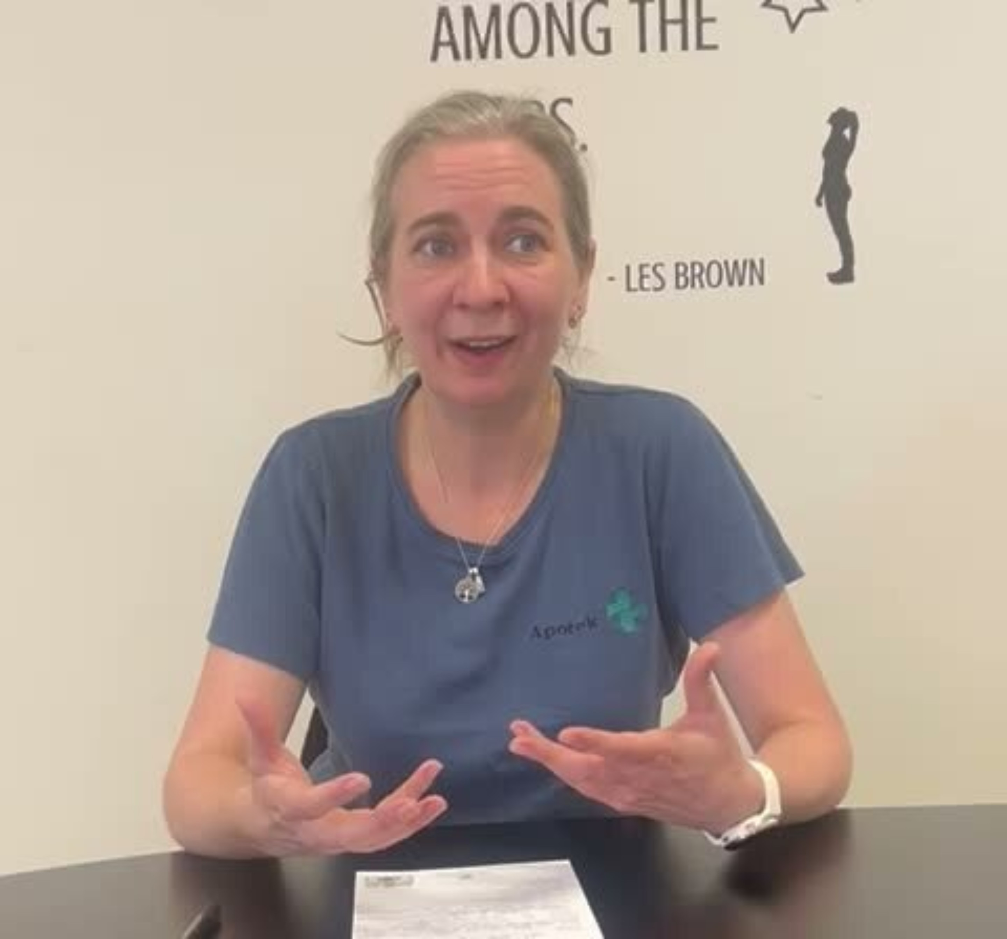
Notes:
Nu vil jeg gerne vise jer en video som Kristine, der er farmakonom på Rødding Apotek, har lavet og sendt til os, så vi kunne dele hendes perspektiv på medicinsamtaler med jer. Vi bad hende sige lidt om hvad der motiverede hende til at holde samtalerne og dele et konkret eksempel på en afholdt medicinsamtale.
Kristine fra Rødding Apotek kom her med sit perspektiv på medicinsamtalen.
Jeg kunne godt tænke mig at vi lige cirkulerede tilbage til det Kristine siger omkring henvisning: For hvordan er det I fanger målgruppen. Der er nogle rammer der skal opfyldes, man skal tjekke de er i målgruppen, og det kan man passende gøre ved at spørge som Kristine siger ”Er det her nyt for dig” ”Har du fået noget tidligere for det samme, altså blodtrykket?” også herefter at invitere til samtalen med interesse. Mit råd er at holde interessen på egen banehalvdel og med det mener jeg – sig fx ”Jeg kunne rigtig godt tænke mig at hjælpe dig godt i gang med din nye medicin, derfor kan vi gå ind her ved siden af og tage en kort snak hvor vi kan tale om det der er vigtigt for dig”. Eller noget lignende. Det er klart her skal i ud og finde jeres egne ord og vendinger som fungerer for jer – men tænk over det her med hvor tilbuddet kommer fra – det kommer fra jeres oprigtige interesse i at hjælpe kunde – med netop det kunden har brug for.
”Vi har mulighed for at vi her på apoteket kan tage en snak om din nye medicin, det hedder en medicinsamtale, jeg tibyder dig samtalen fordi jeg gerne vil hjælpe dig godt i gang”
”Vi kan lige snakke omkring din nye medicin – vi kan snakke om hvad der er vigtigt for dig”
Jeg nævnte også tidligere hvad er vigtigt for dig – fra Dansk Selskab for patientsikkerhed. Det spørgsmål eller variationer heraf er et godt eksempel.
Fra PS!: I kan spørge Hvad er vigtigt for dig? på mange måder:
Er der noget, der fylder ekstra meget lige nu?
Hvad vil du gerne have ud af besøget her i dag?
Kan jeg gøre noget særligt for dig i dag?
Hvad er det, der gør en dag god for dig?
Er der noget vigtigt, jeg ikke har spurgt dig om?
Nu er vi nået til den del der handler om hvad forskningen har af nyt omkring medicinsamtaler.

Slide 33
Nyt fra forskningen
Notes:
Der er gennemført to projekter i forskning- og udviklingsafdelingen her på Pharmakon omkring medicinsamtaler siden den nye bekendtgørelse.
Det først har min kollega Mira El-Souri været projektleder på under titlen ” Dokumentation af medicin- og compliancesamtaler”, hvilket har haft til formål at dokumentere gennemførte medicin- og compliancesamtaler med fokus på indhold, antal samtaler, emner og ressourcer, der tales om, og den vurderede effekt.
Det næste projekt var min kollega Gitte Reventlov Husted som var projektleder på et projekt med titlen ” Hvordan oplever farmakonomer at holde Medicinsamtaler?”, her var formålet netop det - at undersøge, hvordan farmakonomer oplever at holde Medicinsamtaler. Og det er relevant, fordi det er en ændring i farmakonomers arbejdsopgaver på apoteket, og opgaven adskiller sig fra den praksis, som I er uddannet til.

Slide 34
Resultater fra projektet:
Dokumentation af medicin- og compliancesamtaler
Mira El-Souri
Apotek – Kompetence,
Udvikling og Forskning
Pharmakon
Notes:
Hvilke emner taler apoteksmedarbejderen og patienten om i første- og opfølgende samtale, det har vi allerede snakket om. Det var de tidligere slides. Dette projekt kortlagde også

Slide 35
Konklusion
Samtalerne tilbydes primært patienter der inden for de seneste seks måneder har fået ordineret medicin i forbindelse med diagnosticering af en kronisk sygdom (medicinsamtaler)
Både farmaceuter og farmakonomer bidrager til afholdelse af medicinsamtalerne
Alle samtaler fokuserer især på medicin samt vaner og vanskelige situationer
I compliancesamtalerne inddrages relevante ressourcer, der kan støtte patienten
Notes:
Projektet giver os viden om, hvordan medicin- og compliancesamtaler gennemføres på syv danske apoteker. Resultaterne viser, at samtalerne primært tilbydes patienter der inden for de seneste seks måneder har fået ordineret medicin i forbindelse med diagnosticering af en kronisk sygdom – altså medicinsamtalen. Resultaterne viser også at både farmaceuter og farmakonomer bidrager til afholdelse af medicinsamtalerne.
Alle samtaler fokuserer især på medicin samt vaner og vanskelige situationer, og i compliancesamtaler inddrages også relevante ressourcer, der kan støtte patienten.

Slide 36
Konklusion
Patienternes vurdering af samtalerne er meget positiv
Apoteksmedarbejderne oplever, at samtalerne styrker apotekets faglige profil, deres faglighed og relationen til patienterne
Undersøgelsen bidrager med værdifuld viden om styrker og udfordringer i implementeringen af medicin- og compliancesamtaler
Der er stadig forbedringsområder for at opnå en større implementering af begge samtaler herunder gennemførelse af opfølgningssamtalerne.
Notes:
Patienternes vurdering af samtalerne er meget positiv.
Og apoteksmedarbejderne oplever, at samtalerne styrker apotekets faglige profil, deres faglighed og relationen til patienterne. Samtidig peger apoteksmedarbejdernes erfaringerne på, at der er behov for at forbedre rammerne for samtalerne, sikre mere systematisk opfølgning og udvikle mere brugervenlige materialer og praksisnær træning.
Resultaterne bidrager med værdifuld viden om styrker og udfordringer i implementeringen af medicin- og compliancesamtaler. Der er forbedringsområder for at opnå en større implementering af begge samtaler herunder gennemførelse af opfølgningssamtalerne.

Slide 37
Følgende deltog i dette projekt
Apotekerne
  Aarhus City vest Apotek
  Charlottenlund Apotek
  Grindsted Apotek
  Holte Apotek
  Odense Bolbro apotek
  Søborg /Buddinge/Ordrup Apotek
  Thisted Løve Apotek
Projektgruppen
  Mira El-Souri, Pharmakon
  Sara Elgaard Frantzen, Pharmakon
  Charlotte Verner Rossing, Pharmakon
  Julie Engelmann Mollerup, Danmarks Apotekerforening
  Sara Bremer, Apokus, Norge.
Notes:
Til slut vil jeg takke apotekerne, der deltog, projektgruppen, og jer for opmærksomheden.
Den fulde video kan findes på Pharmakons hjemmeside under publikationer, der er også publiceret en rapport som ligeledes kan findes herinde. De to materialer er listet på referencerne til oplægget som er sidste slide.

Slide 38
Resultater fra projektet:
Farmakonomers oplevelse af at holde Medicinsamtale
Projektleder: Gitte R. Husted
Udviklingskonsulent, Ph.d., Cand.Cur., SD
Forsknings- og Udviklingsafdelingen
Pharmakon A/S
Notes:
Velkommen til præsentationen af projektet Farmakonomers oplevelse af at holde medicinsamtaler. Mit navn er Gitte R. Husted og jeg er udviklingskonsulent på Pharmakon i Forsknings- og udviklingsafdelingen. I denne præsentation vil jeg først fortælle kort om baggrunden og formålet med projektet. Så vil jeg fortælle kort om metoden og hvordan vi har indsamlet data og derefter en opsummering på hvad vi fandt i data fra henholdsvis lydoptagelser og fra interviews. Og til sidst vil jeg give en kort opsummering- KLIK

Slide 39
Lidt om projektet
Formål:
At undersøge hvordan farmakonomer oplever at holde Medicinsamtaler.
Deltagere
fem apoteker, to farmakonomer fra hver + en tovholder meldte sig fordelt på fire regioner
Notes:
Formålet med projektet var som sagt at At undersøge hvordan farmakonomer oplever at holde Medicinsamtaler.
Designet ved dette projekt var et kvalitativt studie. For at kunne deltage blev der opstillet nogle inklusionskriterier og rekrutteret herefter. I det her projekt deltog: i alt fem apoteker, to farmakonomer fra hver apotek + en tovholder fordelt på fire regioner
Der blev indsamlet data i to etaper. Den første etape var lydoptagelser, hver farmakonom skulle holde to medicinsamtaler dvs både første del af samtalen og den opfølgende samtale. De skulle lave en lydoptagelse efter hver del af samtalen og på lydoptagelserne skulle farmakonomen reflektere over og besvare nogle spørgsmål.
Næste etape af undersøgelsen – etape 2- fandt sted når lydoptagelserne var lavet. I etape 2 blev farmakonomerne inviteret til et online individuelt interview, hvor formålet var at uddybe og nuancere de refleksioner og erfaringer de havde gjort sig i forbindelse med samtalerne.

Slide 40
Opsummering fra lydfiler
Det der fylder før samtalerne er:
GDPR, formalia – opfylder kunden kriterierne, spørge om at få adgang til FMK. udfylde de rigtige blanketter
At gøre ‘det rigtige’
At kunne huske alt og at kunne svare på alle kundens spørgsmål
Om man kommer igennem ‘det hele’
Nervøse og nervepirrende at skulle være eksperten
Holde tungen lige i munden
Nervøs for at overskride kundens grænser
Nervøs for at bruge for meget tid
Ovenstående er tydeligst ved de første samtaler og aftager efterhånden som erfaringer opnås
Notes:
Hvad viser projektet så fylder før samtalerne, ved at opsummere fra lydfilerne:
Jamen de viser at_
KLIK GDPR, formalia – dvs opfylder kunden kriterierne for at få en medicinsamtale, de giver udtryk for at det er svært at spørge om at få adgang til FMK, der er en usikkerhed om at udfylde de rigtige blanketter og I det hele taget - At gøre ‘det rigtige’
KLIK det fylder At kunne huske alt og at kunne svare på alle kundens spørgsmål det fylder også Om man kommer igennem ‘det hele’
KLIK det kommer også frem på lydoptagelserne at der opleves en nervøsitet og det faktisk er nervepirrende at skulle være eksperten. Det der fylder før er også en forventning til sig selv om at holde tungen lige i munden – altså igen at kunne vurdere og gøre det rigtige. Det der fylder er også at nogen er Nervøse for at overskride kundens grænser i rådgivningen, de er også nervøse for at bruge for meget tid
KLIK ovenstående som fylder før samtalerne er tydeligst ved de første samtaler og aftager efterhånden som erfaringer opnås

Slide 41
Opsummering fra lydfiler
Refleksioner efter samtalerne er:
Oplevelse af at det er meningsfuldt
Kunderne er glade, trygge og takker
Det er megafedt at bruge tid på
Det er ok at slå ting op sammen med kunden
Vi tog det slavisk og kom igennem det hele
Man må bare hoppe ud i det - og hjælpen er jo nær
Man kan mere end man tror
Kunderne takker nej til den opfølgende samtale
Notes:
Så hvad fylder så efter samtalerne og hvilke refleksioner er der kommet fra optagelserne efter samtalerne:
KLIK Der er en oplevelse af at det er meningsfuldt at holde medicinsamtalerne. En oplevelse af at Kunderne er glade, trygge og takker. Farmakonomerne giver udtryk for at Det er megafedt at bruge tid på
KLIK Og de oplever at det faktisk er ok at slå ting op sammen med kunden
KLIK det der fylder efter er at bekymringen for ikke at komme omkring det hele forsvandt fordi som én sagde - Vi tog det slavisk og kom igennem det hele –
KLIK Der var også en oplevelse af at - Man må bare hoppe ud i det – fordi hjælpen er jo nær- man er ikke alene og de kan spørge andre om hjælp, Og der bliver givet udtryk for at man har oplevet at kunne mere end de tror –
KLIK Afslutningsvis reflekteres der over at langt de fleste kunder takker nej til den opfølgende samtale, når de spørger dem. ….

Slide 42
Syv temaer fra individuelle interviews online
Tema 1: Nye arbejdsopgaver: ‘Det var på tide’ / ‘Nice, endelig’
Tema 2: Forestillinger om medicinsamtalen: ‘Troede der var mere i det’
Tema 3: Medicinsamtale i skranken: Det er trygt ‘og det som jeg plejer at gøre’
Tema 5. Hvordan foregår samtalen: ‘Hvem åbner ballet?’
Tema 6: Opfølgende samtale: ‘Det kan være lidt overkilled’ – kunderne takker nej de har ikke tid eller behov for det’
Tema 4: Medicinsamtalen foregår i et andet rum: ‘Skaber en tidslomme’ og signalerer tid og ro til begge parter
Tema 6.1: Opfølgende samtale: ‘Telefonen sælger bedst’
Tema 7: Samtalekortet: ‘er helt ude i hampen’
Tema 7.1: Samtalekortet: En naturlig ting de får med.
Notes:
Hvad kom der så ud af de individuelle interviews:
Data blev opsummeret i syv temaer som I ser på slidet, og de er
KLIK Tema 1: Nye arbejdsopgaver: ‘Det var på tide’ / ‘Nice, endelig
KLIK Tema 2: Forestillinger om medicinsamtalen: ‘Troede der var mere i det’
KLIK Tema 3: Medicinsamtale i skranken: Det er trygt ‘og det som jeg plejer at gøre’
KLIK Tema 3.1: Medicinsamtale foregår i skranken – opleves sårbart at forlade skranken
KLIK Tema 4: Medicinsamtalen foregår i et andet rum: ‘Skaber en tidslomme’ og signalerer tid og ro til begge parter
KLIK Tema 5. Hvordan foregår samtalen: ‘Hvem åbner ballet’
KLIK Tema 6: Opfølgende samtale: ‘Det kan være lidt overkilled’ – kunderne takker nej de har ikke tid eller behov for det’
KLIK Tema 6.1: Opfølgende samtale: ‘Telefonen sælger bedst’
KLIK Tema 7: Samtalekortet: ‘er helt ude i hampen’
KLIK Tema 7.1: Samtalekortet: En naturlig ting de får med.
Eksempler på hvad der er blevet sagt under de enkelte temaer gennemgår vi ikke her, men de kan ses i den fulde video med resultaterne. Det sidste fra dette projekt jeg vil dele er opsamlingen

Slide 43
Opsamling
Hovedparten holder én medicinsamtale
Kunderne takker nej til medicinsamtale 2, når de får valget
Telefonopkald til samtale 2 fungerer godt
Samtalekortet udleveres sjældent – de fungerer når de bruges
Samtalerne holdes i skranken – kendt og trygt for farmakonomen
Hvis i andet rum – er der ro – har erfaring med patientkontakt/anden sundhedsuddannelse
Oplevelse af at det er på tide at få lov til at holde medicinsamtale
Bringer fagligheden i spil på en anden måde og det opleves meningsfuldt
Svært i starten og nervøs for ikke at overholde formalia
Forskellige tilgange til afvikling af samtalen – styret af lister el styret af kundens behov
Notes:
Opsamling viser at Hovedparten holder én medicinsamtale, at Kunderne takker nej til medicinsamtale 2 – når de får valget, og her viser projektet at det bl.a skyldes den måde kunderne bliver spurgt på, hvis man laver opfølgende samtaler så fungerer Telefonopkald til samtale 2 godt –
KLIK Samtalekortet udleveres sjældent men de fungerer når de bruges –
KLIK Samtalerne holdes oftest i skranken og det er kendt og trygt for farmakonomen og opleves ikke meget anderledes end den rådgivning de gav før de blev videreuddannet. Hvis medicinsamtalerne foregår i andet rum – er der mere ro – og her er forskellen, at de som har erfaring med patientkontakt/anden sundhedsuddannelse foretrækker at gå i et andet rum –
KLIK - Der er en Oplevelse af at det faktisk var på tide at få lov til at holde medicinsamtaler Og det gør at man oplever at det Bringer fagligheden i spil på en anden måde og det opleves meningsfuldt –
KLIK Det var især Svært i starten og her var der nervøsitet for ikke at overholde formalia – og det var svært at spørge kunden om adgang til FMK –
KLIK og der er forskellige tilgange til afvikling af samtalen – enten er den styret af en liste som ligger i skranken eller samtalen tager som udgangspunkt afsæt i kundens behov og erfaringer

Slide 44
Følgende apoteker deltog i dette projekt:
København Christianshavn Apotek,
Ringe og Fåborg Løve Apotek,
Rødding Apotek,
Elefant Holbæk Apotek,
Horsens Svane og Løve Apotek
Notes:
Følgende apoteker deltog i dette projekt.

Slide 45
Afrunding
Omkring lidt forskelligt:
  Kort om hvad medicinsamtalen er
  Compliance
  Hørt Kristine fra Rødding Apotek fortælle om hendes oplevelse
  Hvordan farmakonomer har det med at gennemføre medicinsamtaler – nyt fra forskning
Er der nogen af jer der sidder med nogle refleksioner I gerne vil dele?
Notes:
Vi er nået dertil hvor vi skal afrunde: LÆS FRA SLIDE
Er der nogen af jer der sidder med nogle refleksioner I gerne vil dele?
Resultaterne anledning til nogle refleksioner?
Imødekommende overfor frustration. Tænk over om man reelt giver kunden et valg.
Resultaterne fra forskning

Slide 46

Opsummering
Notes:
Opsummerende vil jeg afslutte med at sige:
For nogen handler det om at få taget hul på opgaven og se at det ikke er så ”farligt” som det kan synes. Forskningen viser at det er naturligt at være usikker til en start og tager noget tid at bevæge sig hen mod at blive en ekspert i en ny arbejdsopagave. Find ud af hvor eller hvad der skal til for I er trygge I at komme i gang også få opbygget erfaringen hen mod at arbejdsopgaven bliver en hel naturlig del af arbejdsdagen.
Det vil sige: Find nogle kunder, nogle ekspeditioner hvor I er trygge, som kan inviteres til en medicinsamtale. Husk at det er okay at slå ting op, man måske ikke ved, sammen med kunden – ligesom det er okay at hente sparring eller råd hos en kollega, som måske er jeres ekspert indenfor det I har brug for. Et eksempel kan være Poul der har sagt ja tak til en medicinsamtale, han er nydiagnosticeret med KOL. I samtalen kommer I til at snakke om ernæring, Poul siger ”Jeg får ikke spist så meget, jeg har mistet appetitten lidt”. I henter jeres kollega som er skarp på netop ernæringsdrikke. Eksem/psoriasis – henvise til jeres kollega som er stærk i hudpleje ligesom i sikkert har en kollega der er skarp på rygestop som i kan henvise til, hvis det er relevant for kunden. Vi skal huske, at det vigtigste vi kan gøre i en medicinsamtale, det er at sikre os, at vi taler om det som er relevant for kunden. Så vi skal snakke rygestop, hvis kunden viser interesse for det eller behov for det. Naturvidenskaben i os synes det er relevant for alle med KOL med rygestop, men ….. Det kommer an på den kunden man afholder samtalen med.
Det kan føles som en svær opgave – men meningsfyldt opgave. Det kan vi også se af resultaterne at det der fylder før samtalerne meget er formalia og forventninger til en selv om en vis faglighed, ikke er det der fylder efterfølgende. Efterfølgende fylder XXX.
Data fra forskningen viser at der er forskel på hvordan samtalerne gennemføres – det handler om at I hver især på jeres apoteker finder ud af hvordan i kan sikre at i følger manualen bedst muligt.
Når I starter samtalerne så husk på liv-liv modellen, at møde kunden i deres liv med interesse, så de føler sig set, hørt og forstået – så I kan bruge samtalen til at tale om det er vigtigt for kunden.
Kva naturvidenskaben i os alle – jeg plejer at sige jeg kan vække enhver apoteksansat kl. 3 om natten – redskabskassen den har vi hver især, den fornemmeste opgave er at udvælge netop de redskaber som lige præcis den kunde i sidder overfor har brug for.
Hvor den afholdes: ”Rolige og diskrete omgivelser”.
Resultaterne viser at det er godt for både kunden og den apoteksansatte, da det giver en ro for samtalen og at den apoteksansatte kan være tilstede og ikke bliver forstyrret på samme måde som i skranken.
Samtalekort: I den står ””
Værdien af den opfølgende samtale

Slide 47

Tak for i dag
Notes:
Det var alt hvad jeg havde for i dag ..
Tid til spørgsmål? Spørgsmål som skal besvares?
Tusind tak for jeres tid, tak til farmakonomforeningen fordi jeg måtte være med i dag.
Held og lykke med medicinsamtalerne derude. Rigtig god onsdag til jer alle ☺

Slide 48
Referencer
Medicinsamtale – Nydiagnosticeret kronisk sygdom, Manual, 2025, Apoteksforum
Compliance og medicinefterlevelse: Evidens, teori og praksis på apotek. Pharmakon (2024): https://www.pharmakon.dk/media/2231/20210414_compliance-evidens-teori-og-praksis.pdf
Video: Dokumentation af medicin- og compliancesamtaler – samlet overblik over resultater og konklusion, Pharmakon, 2026
Dokumentation af medicin og compliancesamtaler, rapport, Pharmakon, 2025
Video: Farmakonomers oplevelse af at holde Medicinsamtale, Pharmakon, 2026
Videoer kan ses på Youtube via: Pharmakon forskning og kompetence på apotek

