Slide 1


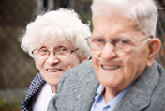

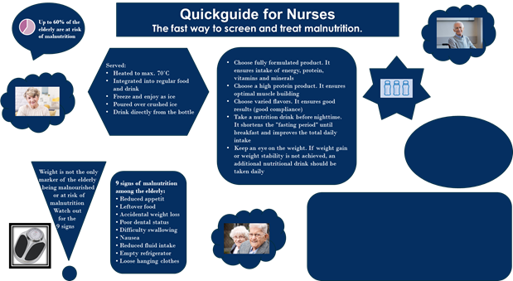


Malnourished elderly in own home –
from pharmacy to patient.
Conducted by Berit Kildegaard & Majbritt Sønderskov. Pharmacy Technicians. Denmark
Background
Studies show that malnutrition is common among elderly people who need regular home health care, and it is estimated that more than 50% has a body mass index below the ideal. We find that the nurses often are very busy and do not have the necessary knowledge and experience to know which products are available and which they should choose, to cover the nutrition needs of the older patients.
Purpose
We want to provide the nursing staff with the necessary knowledge about nutrition therapy, so they will be able to make the right decisions on behalf of their patients, and provide the patients the best possible nutrition and in that way improve their quality of life.
Methods
Interview with elderly patients regarding what kind of help they receive.
Educational sessions for the nursing staff, containing advice for identifying the undernourished elderly patients, product knowledge and formulas for calculating the elderly's need for extra nutrition.
Educational Facts
Why do Patients become malnourished?
When an older patient becomes ill, the body's need for calories and proteins increases, but often it is consumed significantly less. As a result, the body's needs are not met and the patient begins to lose weight. This is referred to as stress metabolism. (see illustration)
9 signs of malnutrition among the elderly:
• Reduced appetite
• Leftover food
• Accidental weight loss
• Poor dental status
• Difficulty swallowing • Nausea
• Reduced fluid intake • Empty refrigerator
• Loose hanging clothes
Consequences.
Malnutrition has consequences for the physical, mental and social functioning of the elderly, and for their well-being and quality of life. The risk of complications associated with other illnesses and infections increases, wound healing is worsened and the time between illness periods is shortened. This has the great societal cost due to frequent and longer hospitalizations
Nutritional requirements.
Protein: approx. 1-1.5 g/kg per day Energy: approx. 35 kcal/kg per day Fluid : approx. 30-40 ml/kg per day
How many nutritional drinks (2 kcal per ml) should the elderly drink
As a full nutrition: In addition:
Approx. 1 bottle (200 ml) per 13 kg Approx. 2-3 bottles daily
Approx. 4-5 bottles at 60 kg. 1 bottle per 25 kg body weight
Preferably between meals and before bed, which shortens the "fasting period" and avoid
taking the appetite from other meals.
Results and Conclusion
Interview with senior citizen.
Older man of 83 years living alone in his own home. Has been hospitalized for 10 days after falling and getting a spinal fracture.
He's a large man who doesn't seem underweight. He has (in his own words) lost between 15-20 kg.
Homecare nurses comes 4 times a day and helps with everything from food preparation to personal care.
Results from the visit.
There is no one to follow up on his daily food intake
No one has decided whether the nutritional drinks meet his needs and whether he gets enough of them.
He does not know how long to use the nutritional supplement
After our visit to the nurses, we found that nutritional therapy is not something that has been given high priority, mainly because of lack of knowledge.
They did not know the difference between the different types of nutritional drinks, in fact they believed that the drinks contained the same and that it was just the taste and texture that varied.
They did not realize that the elderly could have an individual need for the amount and content of nutritional drinks and they didn't know how to calculate how much the elderly needed.
The nurses expressed that they are missing something that can help them identify the malnourished elderly. At the same time, they lack a tool that can quickly support them in choosing the right nutritional drinks and calculate how much the individual elderly needs.
Based on this, we have developed a guide that nurses can use when registering a malnourished elderly patient.
Please take a flyer
This Project has been conducted by
Berit Kildegaard and Majbritt Sønderskov, Nykøbing Apotek, Denmark
with the aid of Danish Phamaconomist Association

